Slide 1
MODULE-01
T3-ASSIGNMENT

Slide 2
Designing an Integrator
(BATCH-01)
211FA05005
211FA05019
211FA05006
211FA05032
211FA05063
Guided by :Dr. P. Vijayalakshmi Mam

Slide 3
Contents
Operational Amplifier(OP-AMP) (introduction)
Integrator
Designing Integrator
Applications Of Integrator

Slide 4
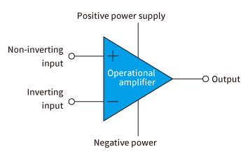
Introduction: Operational Amplifier(OP-AMP)
An operational amplifier is an integrated circuit that can amplify weak electric signals.
An operational amplifier has two input pins and one output pin. Its basic role is to amplify and output the voltage difference between the two input pins.

Slide 5
Types Of OP-AMP’S
Inverting Op Amp
Non-inverting Op Amp
Differential Amplifier
Integrator

Slide 6
Integrator
op-amp integrator performs the function of mathematical integration which gives the integration of the given input.
Integrators are of two types:
Ideal Integrator
Practical Integrator

Slide 7
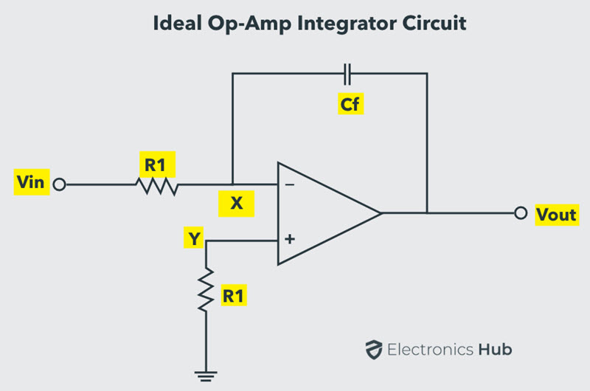

Ideal Operational Amplifier Integrator Circuit
An ideal op-amp integrator uses a capacitor C_{f}, connected between the output and the op-amp inverting input terminal, as shown in the figure below.

Slide 8
Practical Integrator
To avoid the saturation of the output voltage and to provide gain control, a resistor with high value of resistance can be added in parallel with the feedback capacitor C_{f}.
The closed-loop gain of the integrator will be (R₂ / R₁), just like a normal inverting amplifier.
Consequently, at low frequencies of the input signal the circuit behaves normally like an integrator. At high frequencies, the capacitor acts as a short circuit and by-passes the resistor R₂.
The capacitor’s reactance in turn reduces the gain of the amplifier.

Slide 9
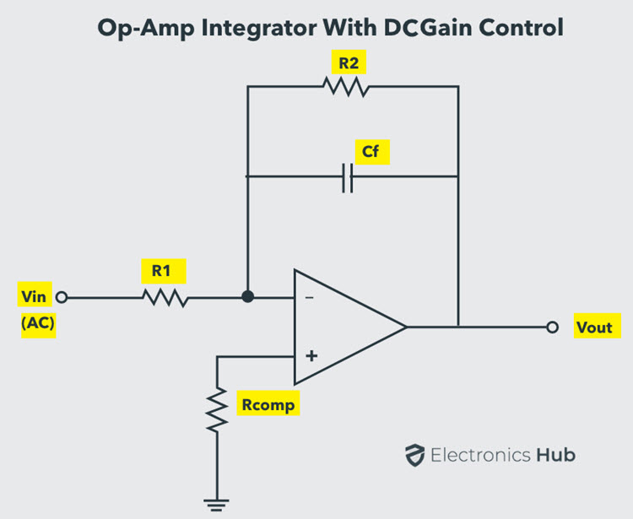

Slide 10
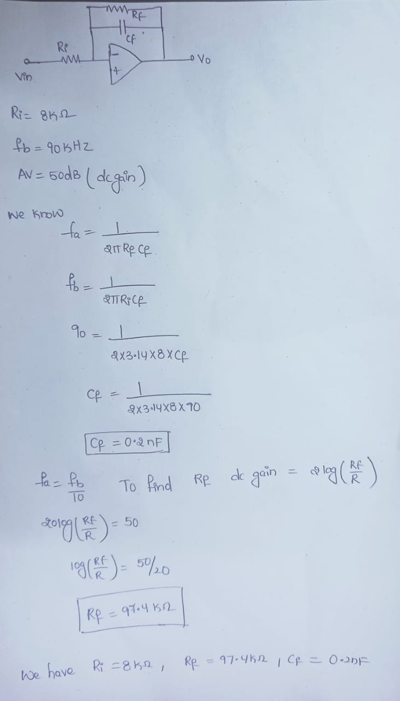
Designing Integrator
Consider an integrator circuit with input resistance 8KΩ and unity-gain frequency is 90 kHz. What components are needed and find their values to design it? Also find the value of a feedback resistor introduced across the capacitor to have long term stability and to limit the dc gain to 50 db. What is the associated lower 3-dB frequency?

Slide 12
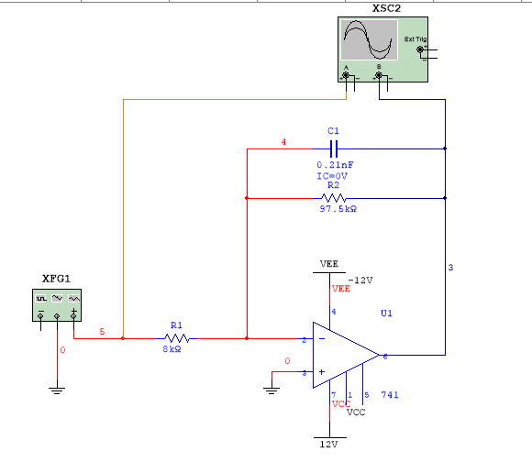
The Designed Integrator

Slide 13
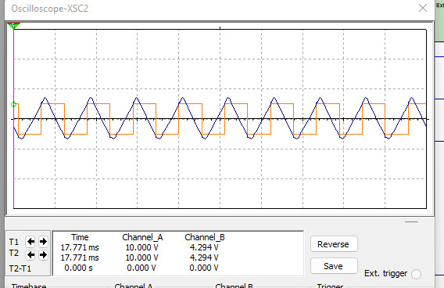
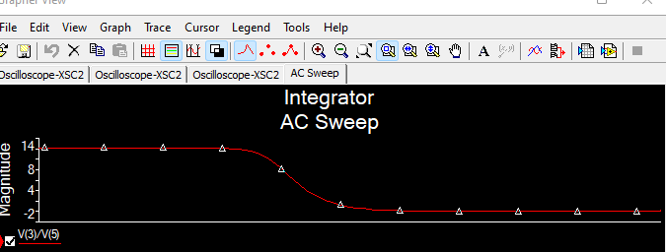
Output Wave Forms & AC Analysis

Slide 14
Op-amp Integrator Applications
Op-amp integrating amplifiers are used to perform calculus operations in analogue computers.
Integrating circuits are most commonly used in analogue-to-digital converters, ramp generators and also in wave shaping applications.
Another application would be to integrate a signal representing water flow, producing a signal representing the total quantity of water that has passed by the flow meter. This application of an integrator is sometimes called a totalizer in the industrial instrumentation trade.

Slide 15
Source: Internet
THANK YOU

